Slide 1
Behavior Driven Development

Slide 2

Overview
Mockito’s approach to Behavior Driven Development (BDD)
Using Mockito’s BDD aliases

Slide 3
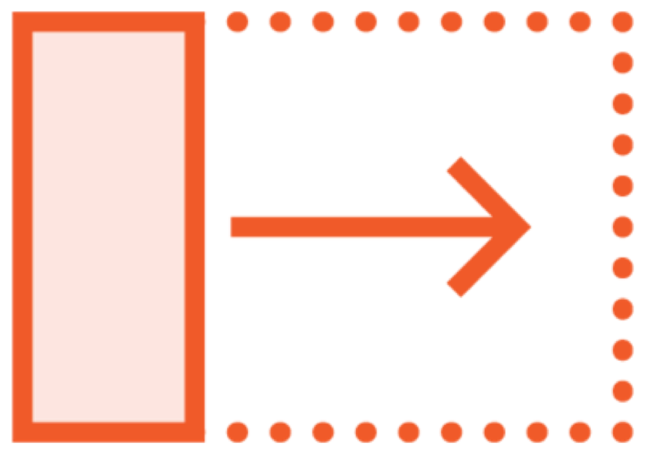


Behavior Driven Development (BDD)
Extension of Test Driven Development
Given When Then
BDDMockito

Slide 4
Mockito’s BDD Aliases
Generic BDD Structure
Mockito non-BDD style
Mockito BDD style
Given When Then
When Exercise behavior
Verify
Given Exercise behavior
Then

Slide 5

Demo
Using Mockito’s BDD aliases

Slide 6
Described Mockito’s approach to BDD
Summary
Used Mockito’s BDD aliases to write new tests and convert existing ones to the BDD style

Slide 7

Getting Started with Mockito

